Slide 1
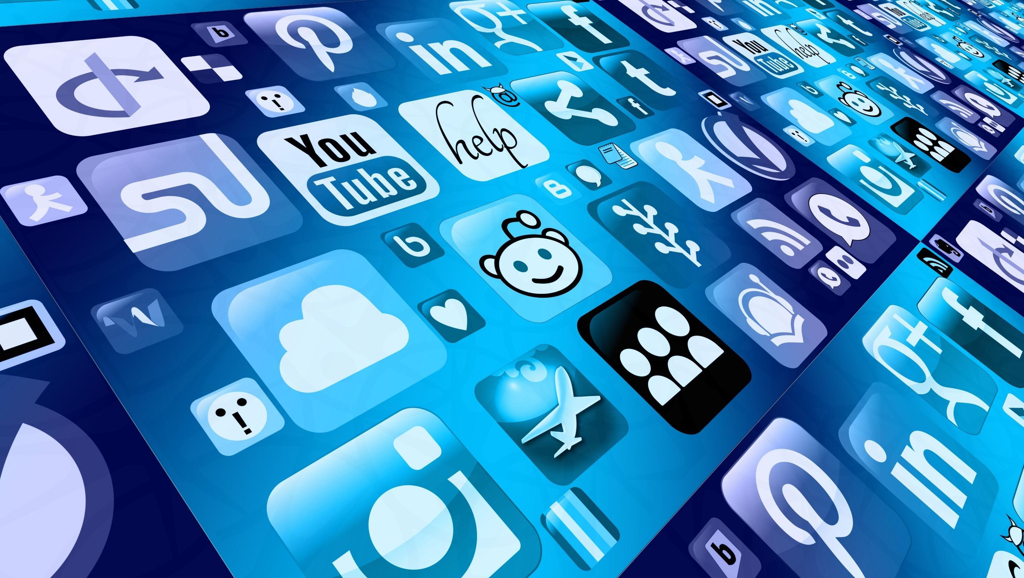
SOCIAL MEDIA & DISINFORMATION
GNED 500
WEEK 9
Image by Gerd Altmann from Pixabay

Slide 2

AGENDA
UPDATE
REVIEW LAST CLASS
LEARNING OUTCOMES
REAL OR FAKE
SOCIAL MEDIA AND DISINFORMATION
SOCIAL MEDIA
INTEREST GROUPS
DISINFORMATION IDEOLOGY
DISINFORMATION
CASE STUDY
DISINFORMATION & DEMOCRACY
FAKE NEWS
FACT CHECK
BIG DATA
SUMMARY
Check 3d by d3images - freepik.com
Notes:
UPDATE
REVIEW LAST CLASS
REAL OR FAKE
SOCIAL MEDIA AND DISINFORMATION
SOCIAL MEDIA
INTEREST GROUPS
DISINFORMATION IDEOLOGY
DISINFORMATION
CASE STUDY
DISINFORMATION & DEMOCRACY
FAKE NEWS
FACT CHECK
BIG DATA
SUMMARY

Slide 3

LEARNING OUTCOMES
At the end of this session, you will be able to:
Identify disinformation in social media.
Examine the forms disinformation can take.
Discuss the motives for creating and spreading disinformation.
Evaluate the impact of disinformation on democratic processes, global citizenship, and yourself.
LEARNING
OUTCOMES
Vector by pch.vector - freepik.com
Notes:
Identify disinformation in social media
Examine the forms disinformation can take
Discuss the motives for creating and spreading disinformation
Evaluate the impact of disinformation on democratic processes, global citizenship, and yourself.

Slide 4
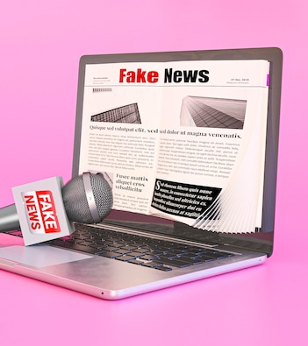
REAL OR FAKE?
Could you tell if a news story is false while you were reading it? Or did you assume it was true?
News stories are often designed to scare you and make you angry without providing any evidence that it is true.
Fake news is a common type of disinformation that counts on you to tell your friends and family about it without asking questions.
We can’t rely on our emotions when we are reading information online—we need to use our heads!
We need to think before we react to information. That is what this module is about.
Fake news photo by freepik.com
Notes:
Could you tell this news story is false while you were reading it? Or did you assume it was true?
News stories are often designed to scare you and make you angry without providing any evidence that it is true.
Fake news is a common type of disinformation that counts on you to tell your friends and family about it without asking questions.
We can’t rely on our emotions when we are reading information online—we need to use our heads!
We need to think before we react to information. That is what this module is about.

Slide 5
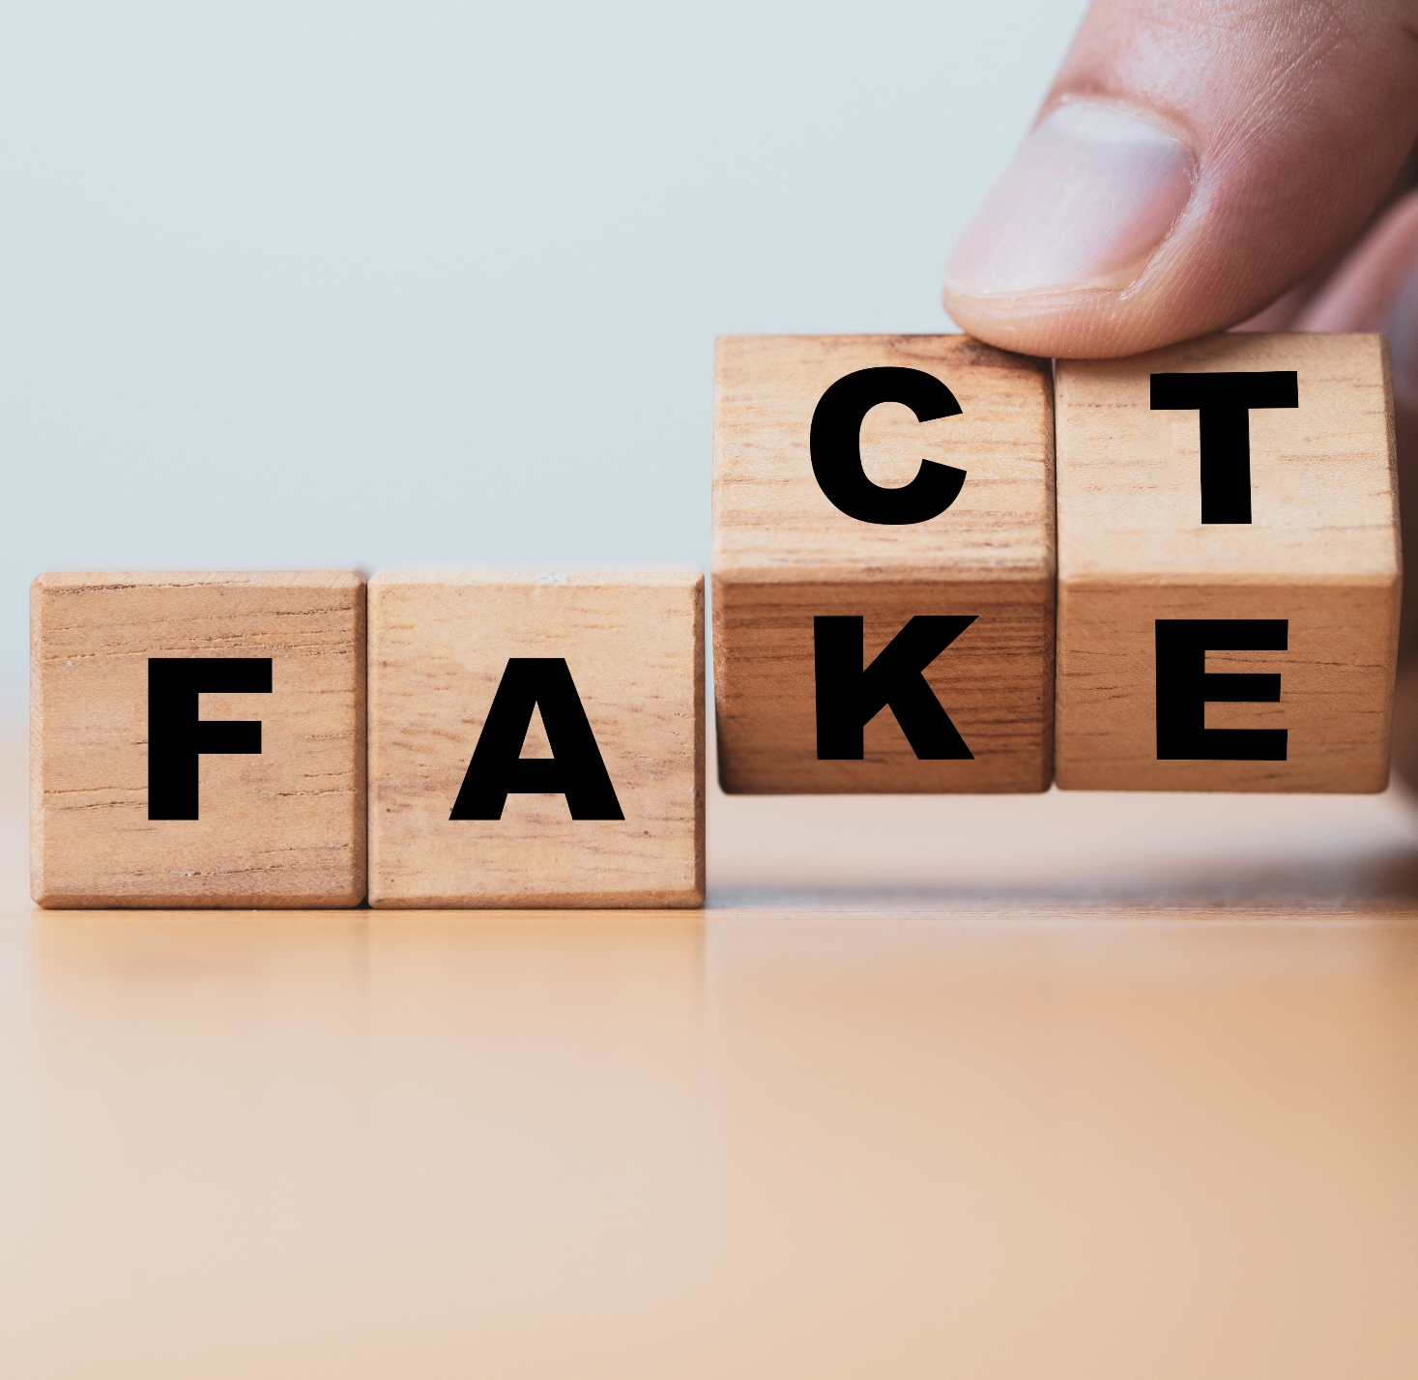
REAL OR FAKE?
Media literacy on the internet is vital for understanding how political, social, and economic groups use the online space.
This module will look at the new realities of social media and how it can both bring people together and divide them.
This includes an examination of “big data” privacy issues, and the online battle over facts and truth—information vs. disinformation.
Global citizenship is based on the interconnectedness of people around the world and understanding the impact of social media is vital for our exploration of social justice and equity.
Image by Dilokastudio - Vecteezy
Notes:
Media literacy on the internet is vital for understanding how political, social, and economic groups use the online space.
This module will look at the new realities of social media and how it can both bring people together and divide them.
This includes an examination of “big data” privacy issues, and the online battle over facts and truth—information vs. disinformation.
Global citizenship is based on the interconnectedness of people around the world, and understanding the impact of social media is vital for our exploration of social justice and equity.

Slide 6
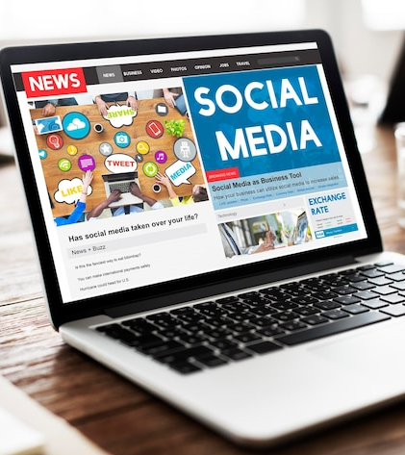
SOCIAL MEDIA &
PUBLIC OPINION
Social media is the new battlefield for public opinion
On the internet, many individuals and groups try to shape your opinions, whether it’s advertisers competing with one another to sell you products, or politicians trying to get your support.
Today, social media platforms compete with traditional information providers like newspapers and television as sources for current events.
If you use social media to stay in touch with friends or keep up with popular trends, you may wonder why you should care about political content on your favourite site.
Let’s start by looking at some statistics on social media use, globally.
Photo by rawpixel.com - Freepik.com
Notes:
Social media is the new battlefield for public opinion
On the internet, many individuals and groups try to shape your opinions, whether it’s advertisers competing with one another to sell you products, or politicians trying to get your support.
Today, social media platforms compete with traditional information providers like newspapers and television as sources for current events.
If you use social media to stay in touch with friends or keep up with popular trends, you may wonder why you should care about political content on your favourite site.
Let’s start by looking at some statistics on social media use, globally.

Slide 7
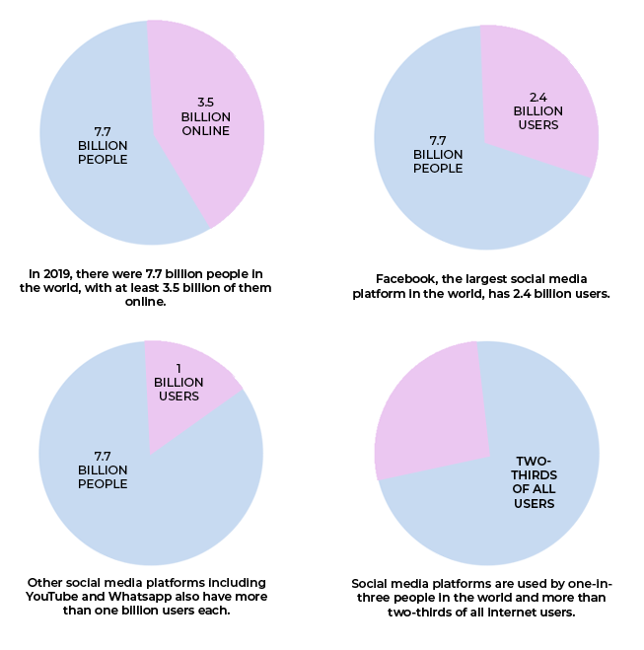
SOCIAL Media
Almost half of the world’s population is online, and a significant number of those people use social media.
Facebook, YouTube, Twitter, Instagram and WhatsApp are impacting the opinions and ideologies of citizens around the globe.
Given these numbers, it is important to consider who is creating that impact on opinions, and how they are doing it.
Notes:
Almost half of the world’s population is online, and a significant number of those people use social media.
Facebook, YouTube, Twitter, Instagram and WhatsApp are impacting the opinions and ideologies of citizens around the globe.
Given these numbers, it is important to consider who is creating that impact on opinions, and how they are doing it.

Slide 8
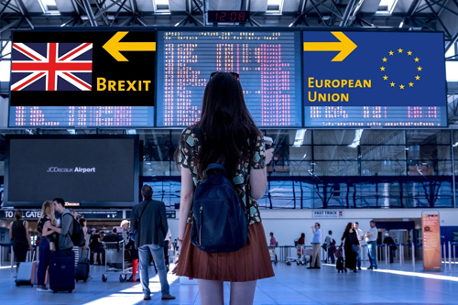
INTEREST GROUPS
Social media platforms are a powerful vehicle for interest groups
Interest groups use social media to promote their agendas to politicians and the general public.
Using social media, interest groups can impact the outcome of national elections and important policy decisions that affect the lives of citizens
Image by stux on Pixabay
Notes:
Social media platforms are a powerful vehicle for interest groups
Interest groups use social media to promote their agendas to politicians and the general public.
Using social media, interest groups can impact the outcome of national elections and important policy decisions that affect the lives of citizens

Slide 9

DISINFORMATION IDEOLOGY
Why is disinformation so effective?
Because people want to believe it, especially when it confirms their own opinions.
Recall from Critical Media Literacy that people end up in echo chamber on the internet with reinforced ideologies
Also from the Ideology module be reminded that ideologies include the beliefs, ideas, and values of individuals.
Photo by pch.vector - freepik.com
Notes:
Why is disinformation so effective?
Because people want to believe it, especially when it confirms their own opinions.
Recall from Critical Media Literacy that people end up in echo chamber on the internet with reinforced ideologies
Also from the Ideology module be reminded that ideologies include the beliefs, ideas, and values of individuals.

Slide 10

DISINFORMATION
Examples of fake news and disinformation aimed can be aimed at people with “ right-wing” beliefs and values.
Those same people can spread that disinformation to other people who think the same way.
They are hearing what they want to hear and ignoring the facts.
It is important to note that people with any ideology are prone to believe what confirms their own views. (Echo Chamber)
Photo by wirestock - freepik.com
Notes:
Examples of fake news and disinformation aimed can be aimed at people with “ right-wing” beliefs and values.
Those same people can spread that disinformation to other people who think the same way.
They are hearing what they want to hear and ignoring the facts.
It is important to note that people with any ideology are prone to believe what confirms their own views. (Echo Chamber)

Slide 11

CASE STUDY
Do you think the Brexit result could have gone differently if British citizens knew that much of the information they were reading about it on social media was designed to manipulate them to vote “yes”?
Image by starline - freepik.com
Notes:
Do you think the Brexit result could have gone differently if British citizens knew that much of the information they were reading about it on social media was designed to manipulate them to vote “yes”?

Slide 12

CASE STUDY
How could fake news on Facebook influence people to vote in favour of leaving the European Union (EU)? Here are some examples of how :
If you are nationalistic fake news about the threat that immigration poses to England’s security could sway you to vote in favour of leaving the EU and closing England’s borders.
If you already believe that England’s traditions and identity are threatened by immigration, then fake news could confirm this—again, you’d vote to leave.
If you were recently unemployed and you were angry about it, then fake news stories could lay the blame on the EU for your job loss—yet again, another vote for Brexit!
A study by King’s College London’s Policy Institute compared what British people believe about immigration with the actual facts about immigration in their country.
Image by freepik.com
Notes:
How could fake news on Facebook influence people to vote in favour of leaving the European Union (EU)?
Here are some examples of how :
If you are nationalistic fake news about the threat that immigration poses to England’s security could sway you to vote in favour of leaving the EU and closing England’s borders.
If you already believe that England’s traditions and identity are threatened by immigration, then fake news could confirm this—again, you’d vote to leave.
If you were recently unemployed and you were angry about it, then fake news stories could lay the blame on the EU for your job loss—yet again, another vote for Brexit!
A study by King’s College London’s Policy Institute compared what British people believe about immigration with the actual facts about immigration in their country.

Slide 13
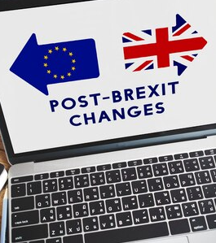
CASE STUDY
Facebook was a huge influence on voters.
Voters read anti-EU disinformation, purchased by right-wing interest groups.
Interest groups, posted lies and inaccuracies about the EU, and it was impossible to trace the source
EEA migrants as a whole paid £4.7bn more in taxes than they received in welfare payments and public services however over 2200 people believed they received the same or paid less in taxes
56% polled & 75% of Leave supporters – think European immigration has increased crime levels, but the MAC found no evidence of any link.
39% of the public and 53% of Leave voters think European immigration has led to a decline in healthcare services, even though MAC evidence showed as well that this was false.
So where did people get these wrong ideologies from?
Laptop coffee photo by rawpixel.com - freepik.com
Data collected by the Migration Advisory Committee (MAC),
Notes:
Facebook was a huge influence on voters.
Voters read anti-EU disinformation, purchased by right-wing interest groups.
Interest groups, posted lies and inaccuracies about the EU, and it was impossible to trace the source
EEA migrants as a whole paid £4.7bn more in taxes than they received in welfare payments and public services however over 2200 people believed they received the same or paid less in taxes
56% polled & 75% of Leave supporters – think European immigration has increased crime levels, but the MAC found no evidence of any link.
39% of the public and 53% of Leave voters think European immigration has led to a decline in healthcare services, even though MAC evidence showed as well that this was false.
So where did people get these wrong ideologies from?
You can see there is a disconnection between the perception of European immigration to Britain and the reality of it—and this type of misunderstanding can be fueled by disinformation, as it was in the Brexit vote.

Slide 14

Disinformation & Democracy
Political groups spread disinformation - false information used to deceive or manipulate people.
One form of disinformation is fake news - this refers to false stories, usually online, that seem like genuine news and can be used to sway the opinion of the viewer.
Often times these news stories are used to sway people opinions
Photo by Dinnow from Pexels
Notes:
Political groups spread disinformation - false information used to deceive or manipulate people.
One form of disinformation is fake news - this refers to false stories, usually online, that seem like genuine news and can be used to sway the opinion of the viewer.
Often times these news stories are used to sway people opinions

Slide 15
Disinformation & Democracy
The reality that many groups are not represented by their governments, even in Canada.
Indigenous peoples, poor people, and other groups may not be recognized nor served by their elected governments to the same extent as privileged groups within this country.
Dominant groups have greater power, even in elected governments.
Societal cultural issues are often played up in the news to cause polarization and backup ideologies
Photo by Dinnow from Pexels
Notes:
The reality that many groups are not represented by their governments, even in Canada.
Indigenous peoples, poor people, and other groups may not be recognized nor served by their elected governments to the same extent as privileged groups within this country.
Dominant groups have greater power, even in elected governments.
Societal cultural issues are often played up in the news to cause polarization and backup ideologies

Slide 16

Fake news — real profit
What motivates people to produce fake news and disinformation?
Why would anyone want to do it?
Fake news can be used for both political purposes and profit.
Fake News Photo by freepik.com
Photo by SHVETS production
Notes:
What motivates people to produce fake news and disinformation?
Why would anyone want to do it?
Fake news can be used for both political purposes and profit.

Slide 17
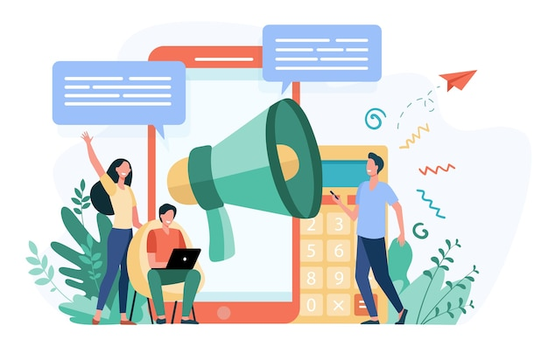
Fake news — OLD STORY: NEW FORMAT
Most fake news is created for money.
Fake news is also created for political reasons.
Sensational stories are easier to “ monetize” on the internet, as they attract more views and, thus, more advertisers.
People with ideological biases will embrace and spread fake news if it reinforces their ideological views.
Conspiracy theories are easy to create and spread online.
People are willing to believe and spread fake news and conspiracies without checking the facts.
Vector by pch.vector - freepik.com
Notes:
Most fake news is created for money.
Fake news is also created for political reasons.
Sensational stories are easier to “ monetize” on the internet, as they attract more views and, thus, more advertisers.
People with ideological biases will embrace and spread fake news if it reinforces their ideological views.
Conspiracy theories are easy to create and spread online.
People are willing to believe and spread fake news and conspiracies without checking the facts.

Slide 18
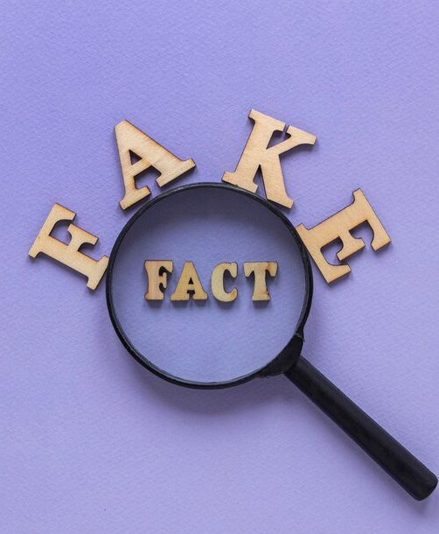
FACT CHECK FIRST!
You're most likely to come across disinformation on social media, especially on Facebook and Twitter, but also on YouTube, Snapchat, Instagram and Reddit.
You may be sent disinformation or misinformation if you're in groups on messaging apps like WhatsApp or WeChat.
It is important that you should fact check before posting and or sharing anything!
Photo by freepik - freepik.com
Photo by SHVETS production
Notes:
You're most likely to come across disinformation on social media, especially on Facebook and Twitter, but also on YouTube, Snapchat, Instagram and Reddit.
You may be sent disinformation or misinformation if you're in groups on messaging apps like WhatsApp or WeChat.
It is important that you should fact check before posting and or sharing anything!

Slide 19

BREAK
Photo by Hannah Tims on Unsplash
Notes:
15 Minute Break
This slide can be moved to where you have your class break(s)

Slide 20


ATTENDANCE
ATTENDANCE MATTERS
Image by pch.vector - freepik.com
Notes:
This attendance slide can be moved to wherever in your class that you take attendance.
Usually attendance is taken around class breaks, or at the beginning or at the end of class.

Slide 21
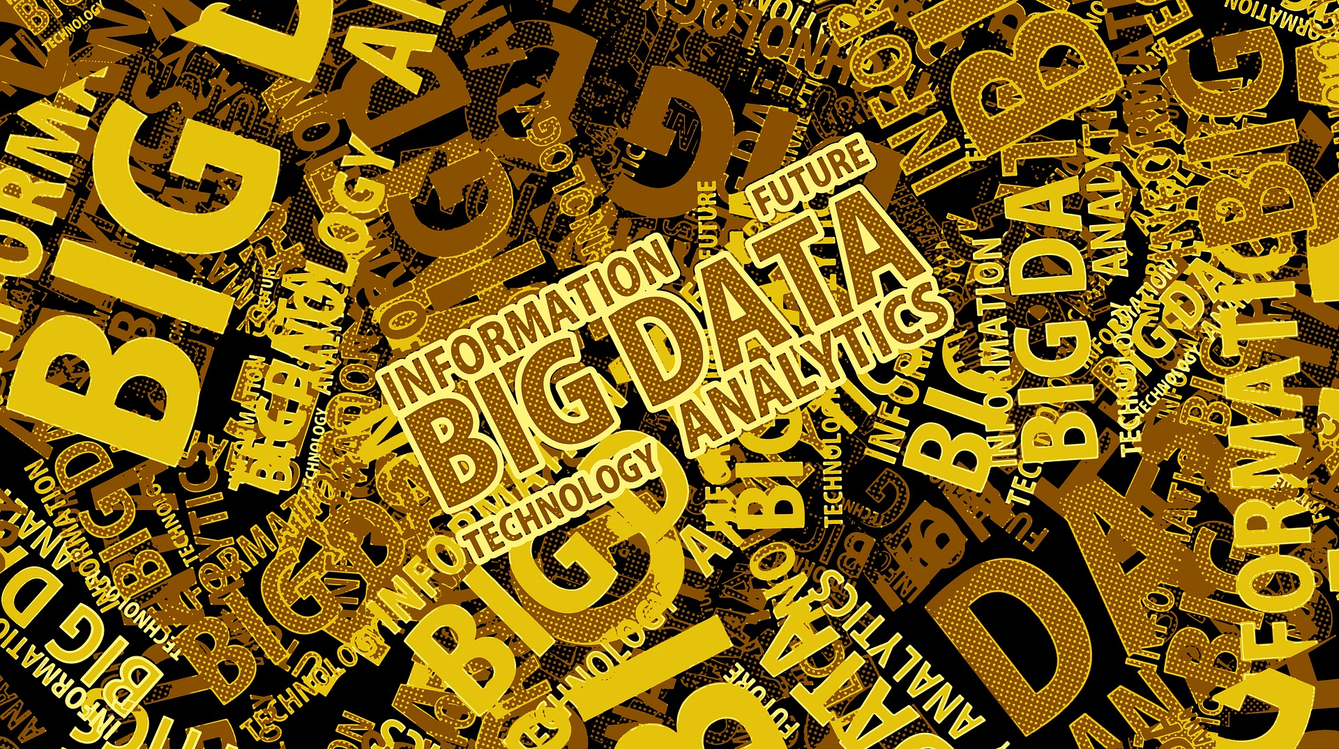
Photo by Gerd Altmann from Pixabay
Notes:
Big data is often characterized by the 5Vs:
Volume
the large volume of data in many environments,
Variety
the wide variety of data types stored in big data systems and
Velocity
the velocity at which the data is generated, collected and processed
Veracity
The veracity of big data denotes the trustworthiness of the data
Value
Organizations that have not created a data strategy to yield insights and to drive data-driven decision-making are going to fall behind competitors.
Let’s have a look at Big Data
The Guardian explains how data is gathered on individuals. It also explains what companies can do with this information, such as target advertisements and political campaigns, or predict your future actions. (Source: The Guardian, 2019)

Slide 22
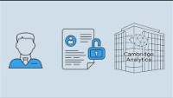
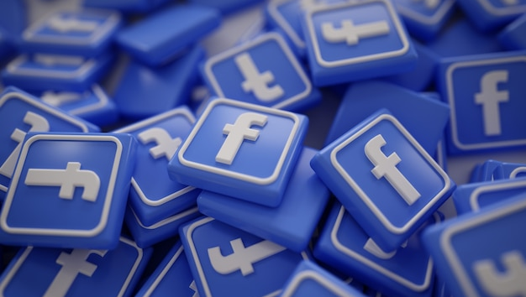
Photo by natanaelginting - freepik.com
Notes:
Facebook criticism
https://youtu.be/U4qooWtovhU
The Case of Cambridge Analytica and the Trump Campaign

Slide 23
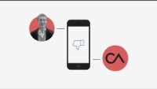
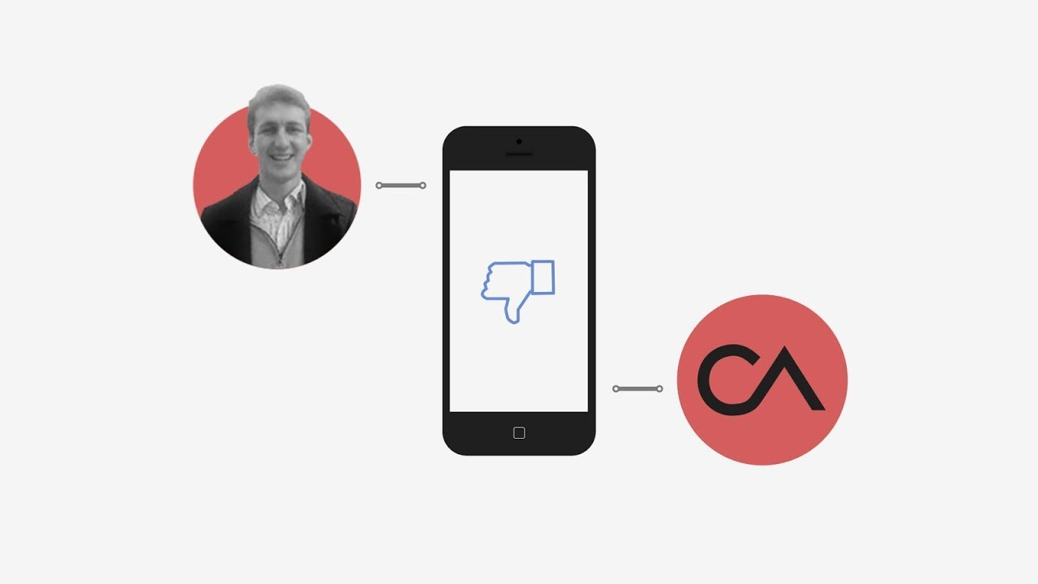
Notes:
How Cambridge Analytica Exploited the Facebook Data of Millions
Tens of millions of American Facebook users had their data harvested by Cambridge Analytica and a British-based researcher. Here’s how it happened.
https://youtu.be/mrnXv-g4yKU

Slide 24
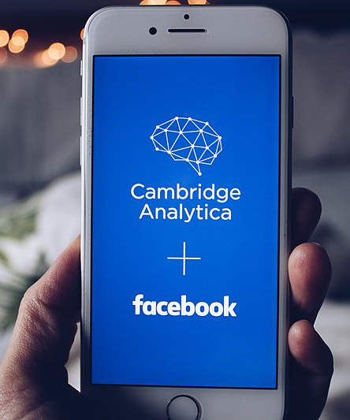
BIG DATA
Cambridge Analytica Ltd was a British political consulting firm that came to prominence through the Facebook–Cambridge Analytica data scandal.
Cambridge Analytica developed an app called "This Is Your Digital Life" and arranged informed consent process for research and then used facebook to collect personal information from survey respondents and their Facebook friends.
This data was obtained illegally.
Photo by shopcatalog.com - Flickr (CC BY 2.0)
Notes:
Cambridge Analytica Ltd was a British political consulting firm that came to prominence through the Facebook–Cambridge Analytica data scandal.
Cambridge Analytica developed an app called "This Is Your Digital Life" and arranged informed consent process for research and then used facebook to collect personal information from survey respondents and their Facebook friends.
This data was obtained illegally.

Slide 25
BIG DATA
This data was then used to be able to create ideological profiles and disseminate fake news and disinformation in order to bring about desired results in elections
Cambridge Analytica used research on Facebook users and their contacts to manipulate their political views without their consent
Examples …
Pro-Russian Czech president campaign
Ted Cruz campaign
Donald Trump campaign
Brexit Vote Campaign
Photo by shopcatalog.com - Flickr (CC BY 2.0)
Notes:
This data was then used to be able to create ideological profiles and disseminate fake news and disinformation in order to bring about desired results in elections
Cambridge Analytica used research on Facebook users and their contacts to manipulate their political views without their consent
Examples …
Pro-Russian Czech president campaign
Ted Cruz campaign
Donald Trump campaign
Brexit Vote Campaign

Slide 26
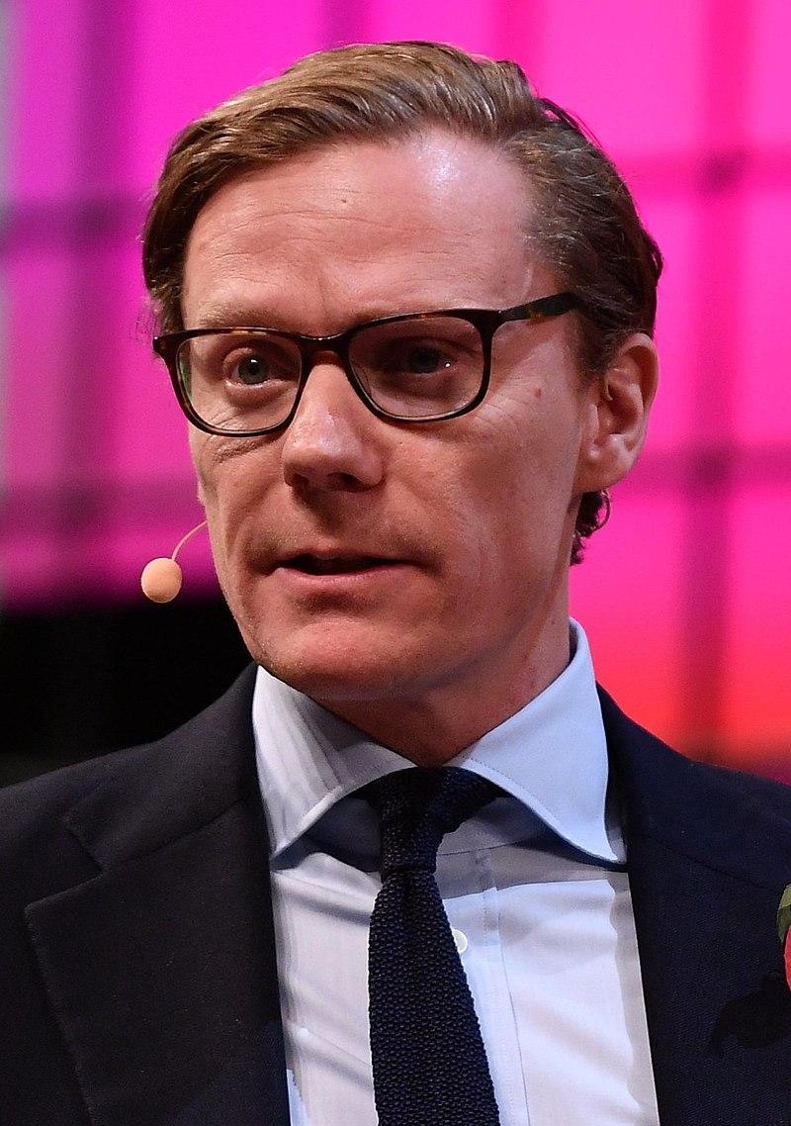
OUTCOMES
Nix had allowed companies to offer potentially unethical services, including
“bribery or honey-trap stings,
voter disengagement campaigns,
obtaining information to discredit political opponents
spreading information anonymously in political campaigns
Alexander Nix, boss of Cambridge Analytica, was banned from serving as a company director for 7 years
Photo byWeb Summit - SAM_7378 CCBY 2.0
Notes:
Nix had allowed companies to offer potentially unethical services, including
“bribery or honey-trap stings,
voter disengagement campaigns,
obtaining information to discredit political opponents
spreading information anonymously in political campaigns
Alexander Nix, boss of Cambridge Analytica, was banned from serving as a company director for 7 years

Slide 27
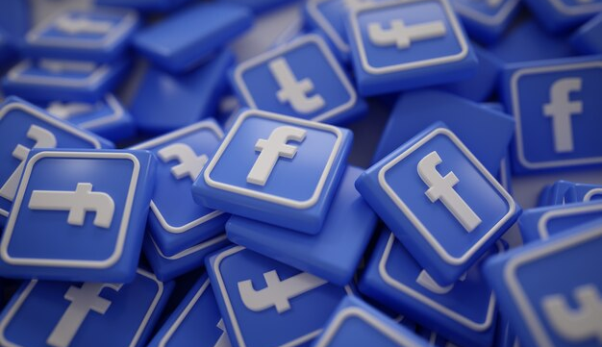
How conservatives learned to wield power inside Facebook
Photo by natanaelginting - freepik.com
Notes:
Facebook created “Project P” — for propaganda — in the hectic weeks after the 2016 presidential election and quickly found dozens of pages that had peddled false news reports ahead of Donald Trump’s surprise victory. Nearly all were based overseas, had financial motives and displayed a clear rightward bent.
https://www.washingtonpost.com/technology/2020/02/20/facebook-republican-shift/

Slide 28
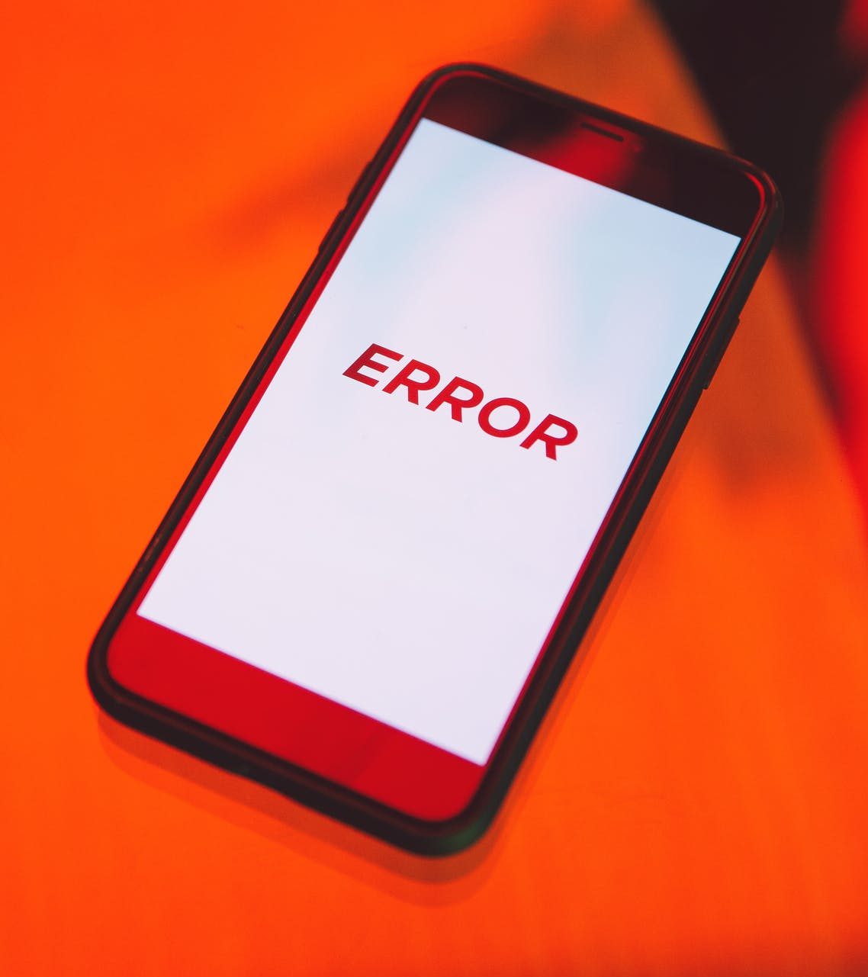
summary
As great as social media can be for connecting people, it is also a means to influence people—even without their knowledge.
We are profiled on social media. That “consumer intelligence” is sold and used.
When distorted or untrue information is intentionally placed on social media to disrupt elections and major policy decisions, it threatens truth and democracy.
Disinformation, fake news and deepfakes are everywhere online now.
We must employ critical media literacy, fact check, and resist being manipulated by your own biases.
Photo by Polina Zimmerman from Pexels
Notes:
Summary
•As great as social media can be for connecting people, it is also a means to influence people—even without their knowledge.
•We are profiled on social media. That “consumer intelligence” is sold and used.
•When distorted or untrue information is intentionally placed on social media to disrupt elections and major policy decisions, it threatens truth and democracy.
•Disinformation, fake news and deepfakes are everywhere online now.
•We must employ critical media literacy, fact check, and resist being manipulated by your own biases.

Slide 29
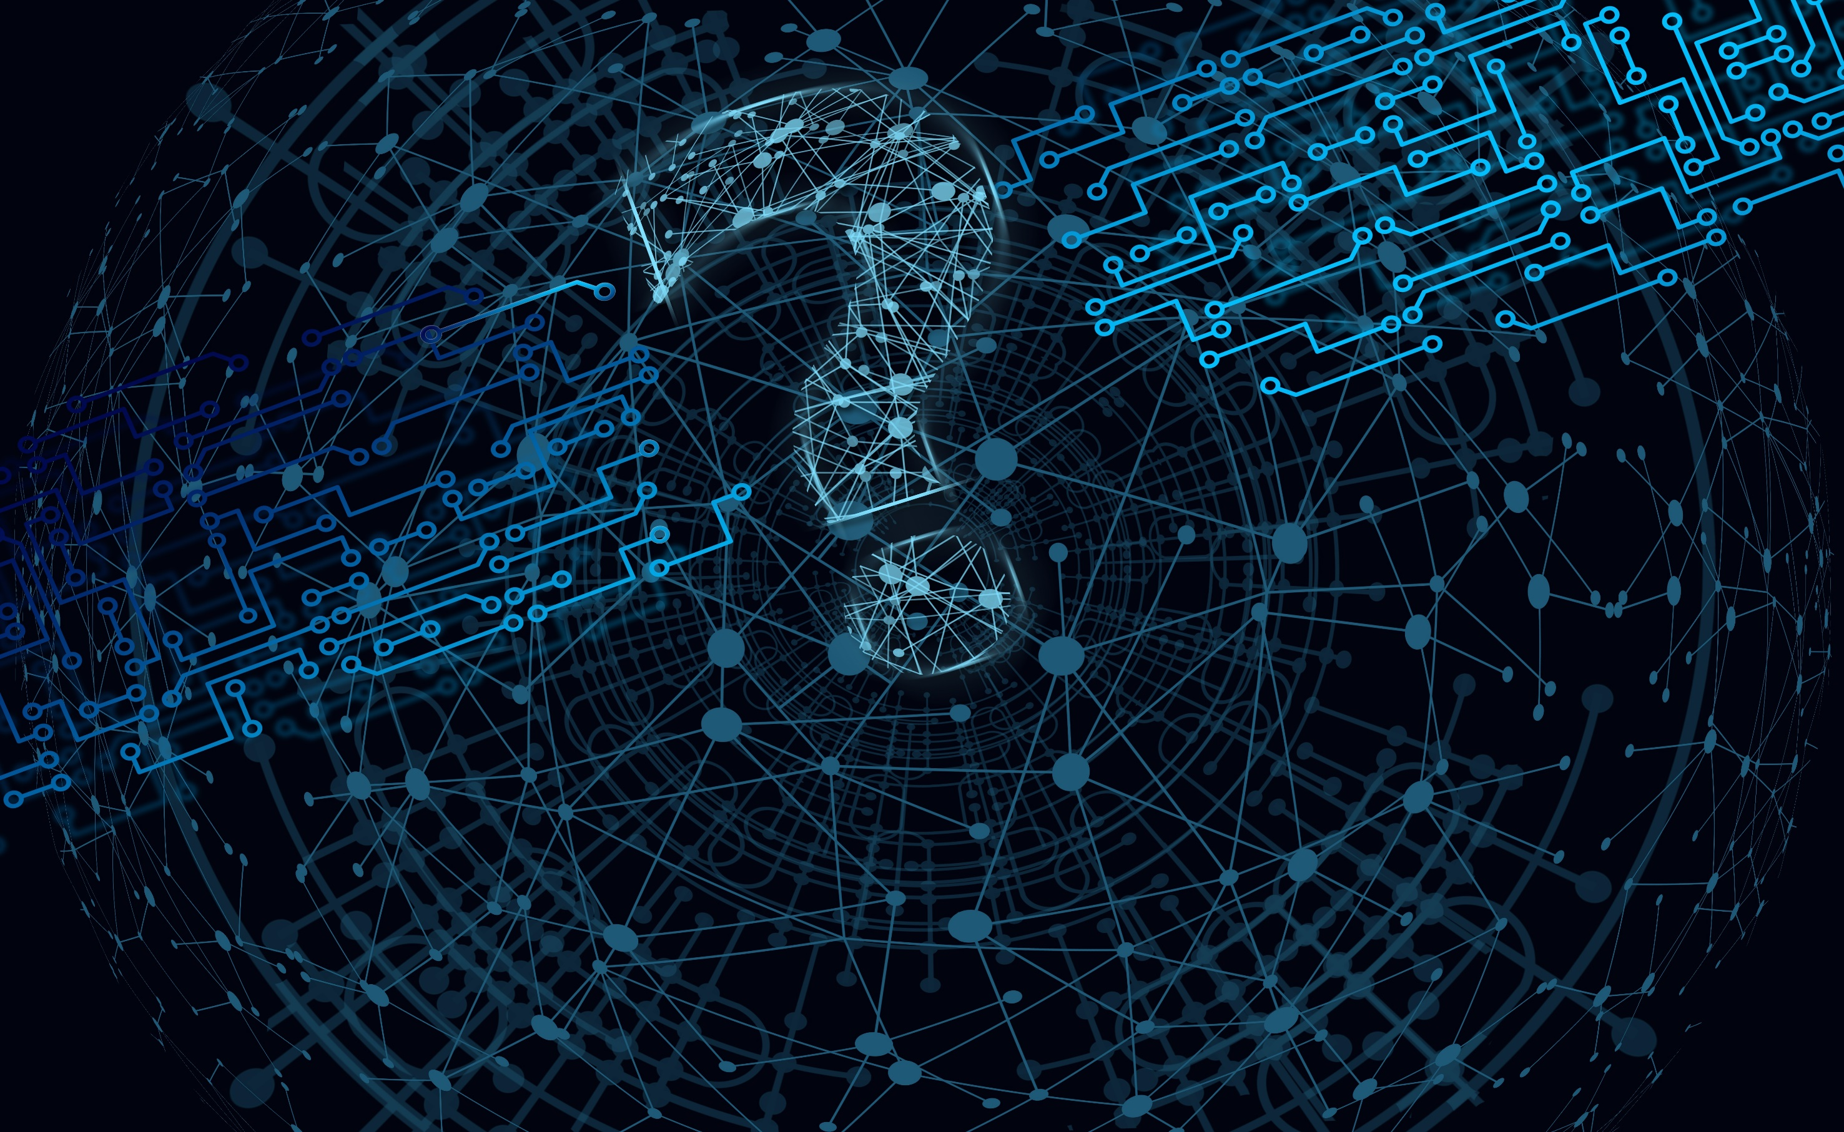
QUESTIONS
Photo by Gerd Altmann from Pixabay
Notes:
Questions

